Slide 1




Slide 2

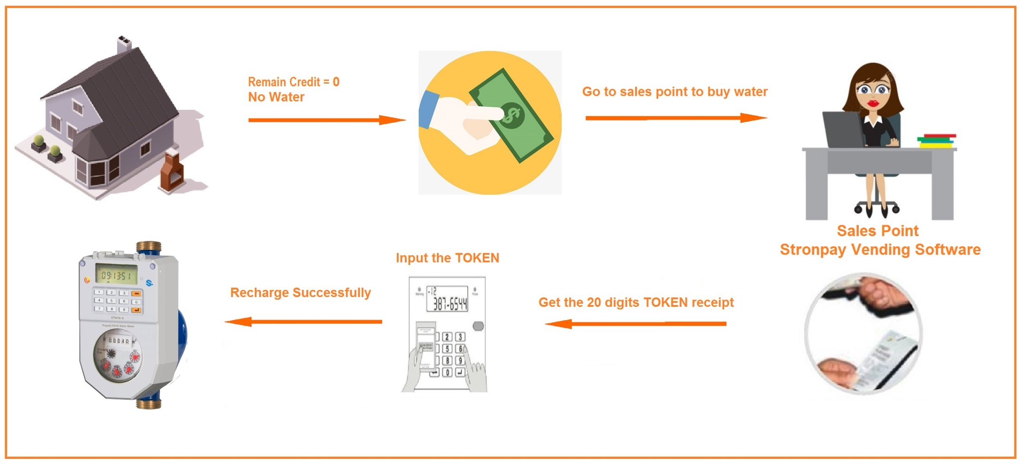

Prepayment Management System
The system adopts the Enhanced Client /Server database, covering entire workflow and works perfectly with all types of prepaid meters.

Slide 3
Prepayment Management System
Software Interface

Slide 4
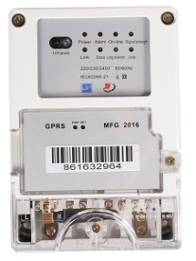



Prepayment Management System
Third Party Payment Connection
GPRS
APP Server
Server
Data concentrator
Internet
API
RF(Lora)
Pay Vending Software
Water meter
Third Party Payment APP
Changde Metering system

Slide 5
Prepaid STS Water Meter
STS Keypad Prepaid Water Meter
Functions and Features
STS standard compliant
Directive 2014/32/EU, OMIL R-49 compliant
Ratio “R” Q3/Q1=R160（Up to 400)
Perfectly water proof IP54
Prepaid and post-paid hybrid
Pre-programmable low credit warning
Automated meter reading and Valve controlling
Over 5 years’ data storage in absence of power
Reading through RF-LORA, NB-IOT
Non-return valve preventing back-flow

Slide 6
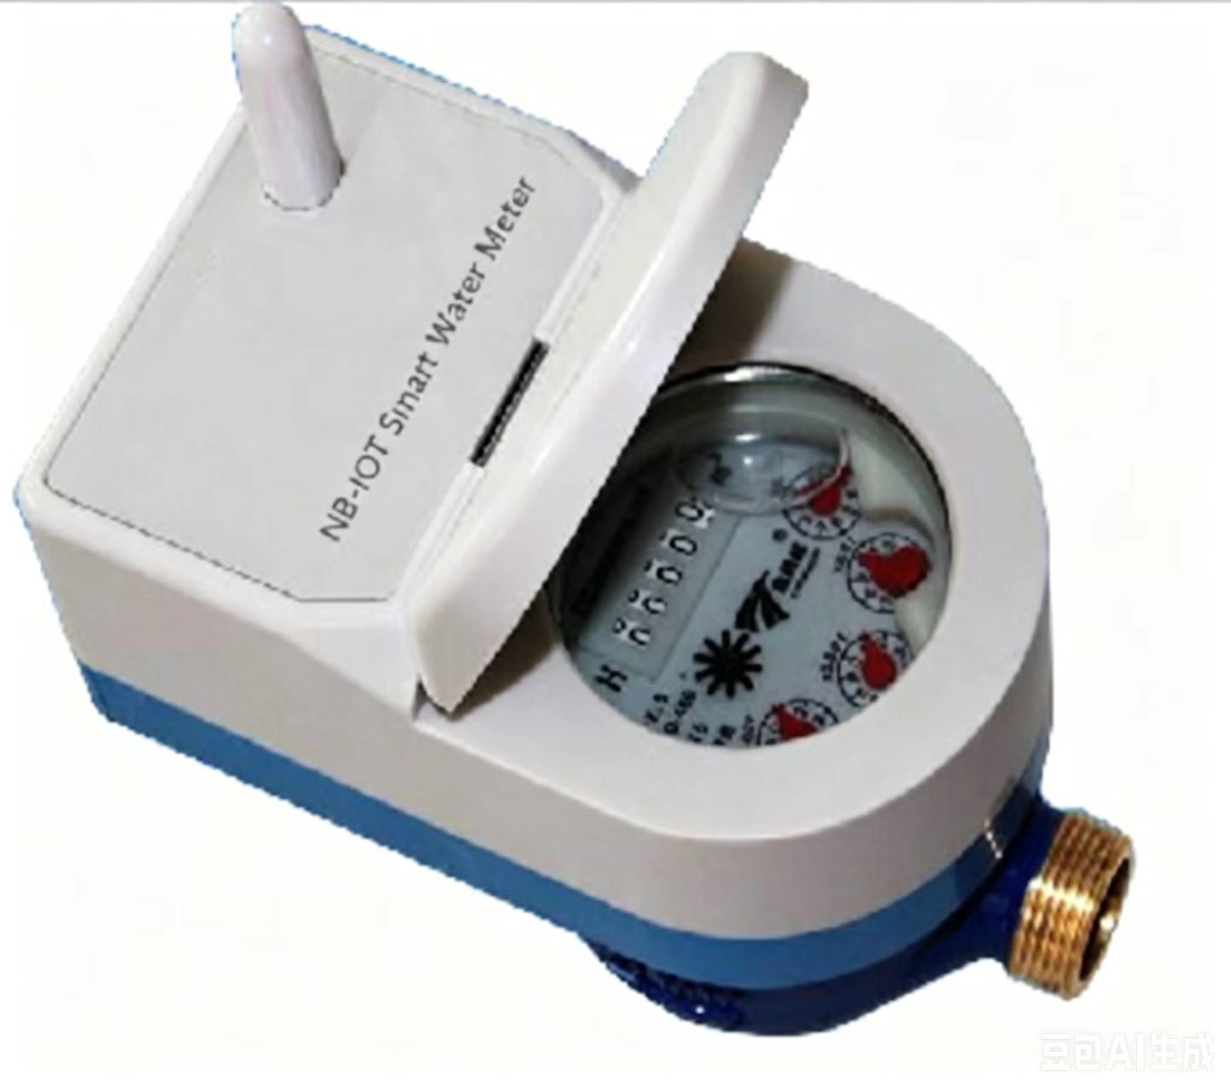
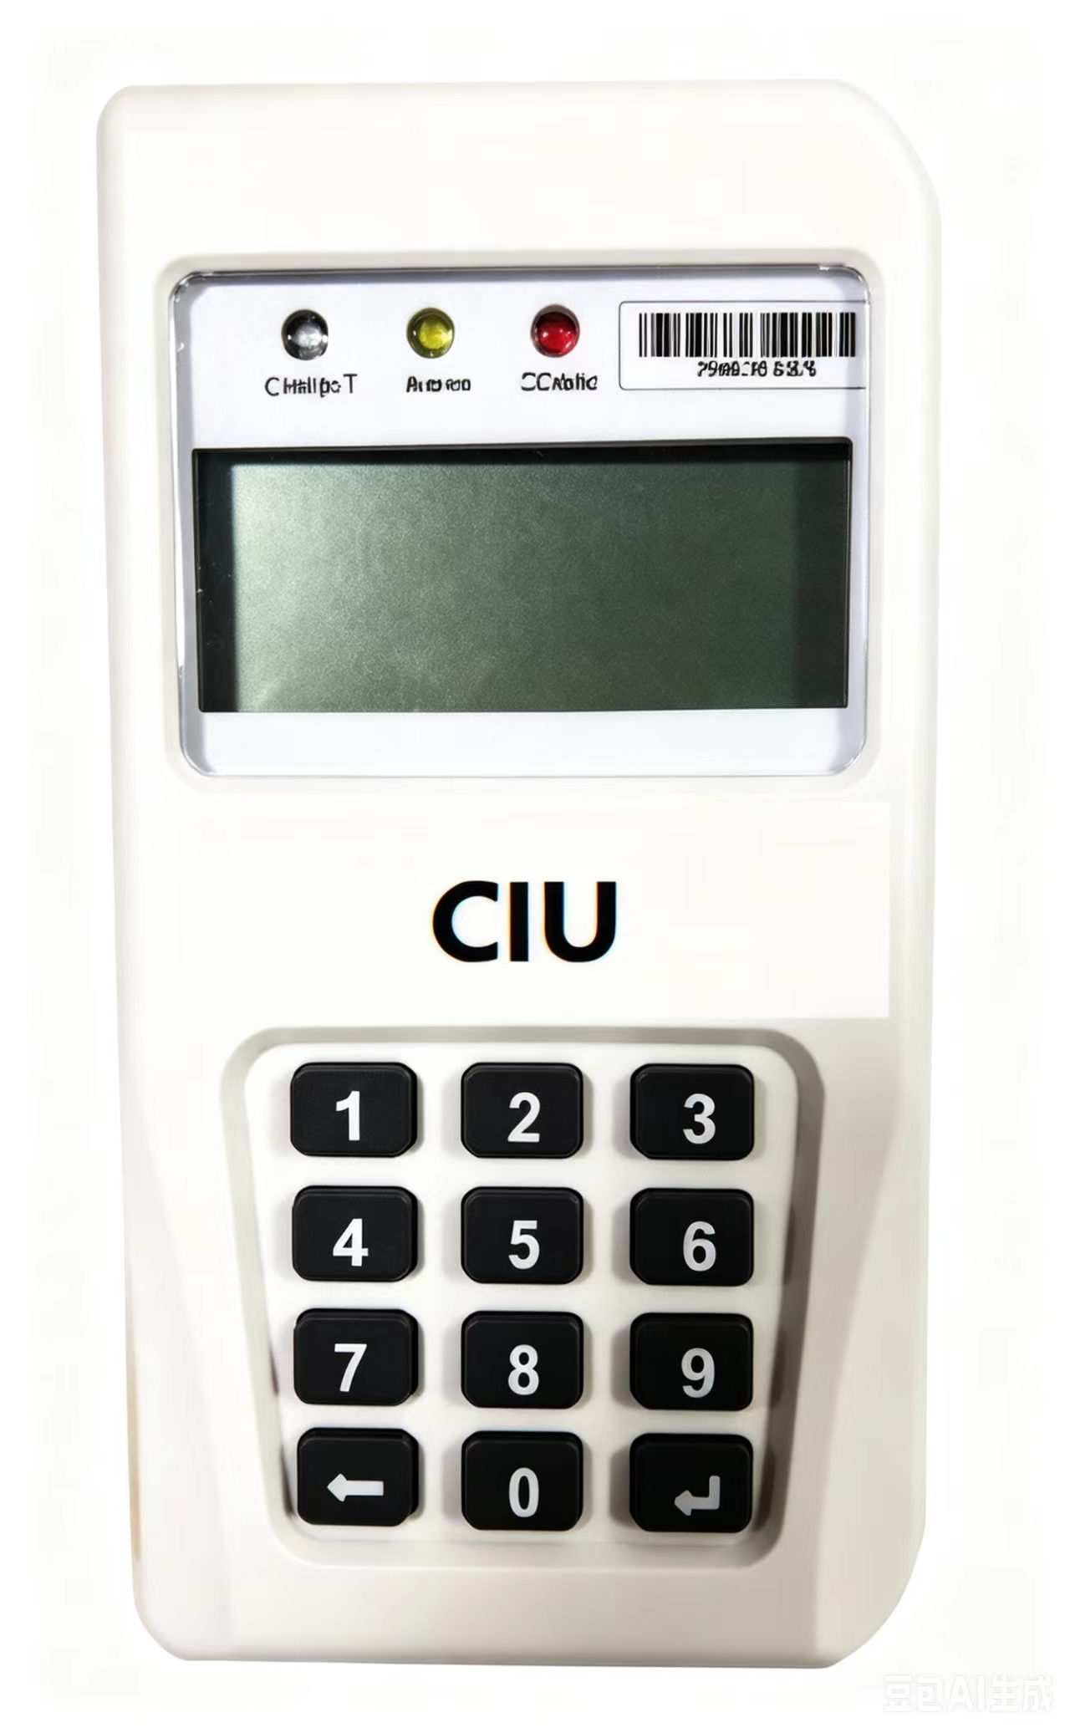
Prepaid STS Water Meter
Split Keypad Prepaid Water Meter
Functions and Features
STS standard compliant
Handy remote keypad, as Customer Interface Unit(CIU)
Ratio “R” Q3/Q1=R100（or R160)
Directive 2014/32/EU, OMIL R-49 compliant
Perfectly water proof IP68
Prepaid and post-paid hybrid
Pre-programmable low credit warning
Automated meter reading and Valve controlling
Over 10 years’ data storage in absence of power
Brass / plastic meter body on request
CIU Recharging and Reading through RF-LORA
Non-return valve preventing back-flow

Slide 7
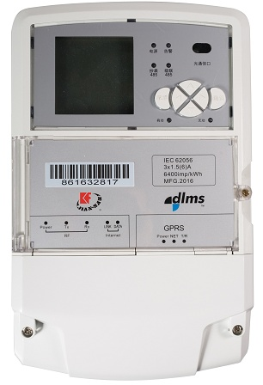
Data Concentrator
Functions and Features
Gateway for communication between head-end
station and meters
TCP/IP protocol over Ethernet and 2G/3G modem uplink with head-end system
PLC/ RF/ RS485 down-link with meters
Java application compatible Pre-programmable low credit warning
Technical Parameters
Operating voltage 1x230V or 3x 230/400V
Voltage range: 0.8 Un - 1.2 Un
Frequency: 50 Hz Protection Class: IP54
Storage flash memory: 256MB
EMC compliant with Directive 2004/108/EC
Dimension: 280x180x85 mm Weight: 3kg

Slide 8
THANKS

