Slide 1
ETC Solution
01
ETC system overview
02
Core technology analysis
catalogue
03
System workflow
04
Key equipments and functions
05
Technical advantages and challenges
06
Application cases and development trends

Slide 2
ETC System Overview
01

Slide 3
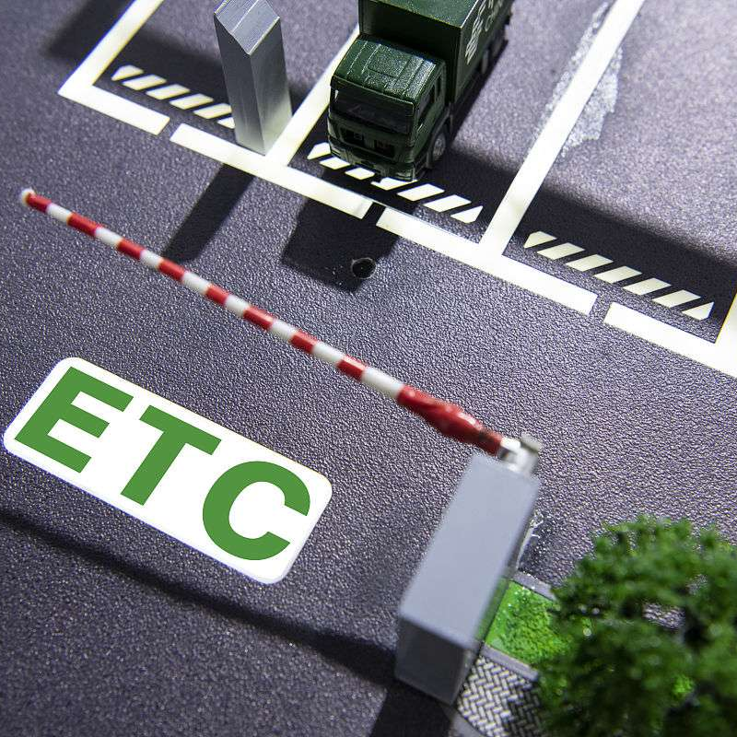
Definition and basic principles
Two-way communication mechanism
Electronic payment model
The system relies on the short-range 5.8GHz microwave communication between the OBU(On Board Unit) and the RSU(Road Side Unit). The OBU sends the vehicle identity information, and the RSU receives it and completes real-time fee deduction through the backend settlement system. The communication response time is less than 0.3 seconds.
ETC (Electronic Toll Collection) is an intelligent transportation system that uses radio frequency identification (RFID) technology to automatically collect tolls for vehicles while they are driving. The core goal is to improve traffic efficiency and reduce manual intervention.
Path restoration technology
In the free flow charging scenario, the multi-level gantry system is used to record the vehicle passage trajectory, and cloud computing is combined to realize accurate path fitting and segmented billing, with an error rate of less than 0.1%.

Slide 4



System composition and architecture
01
On-board unit (OBU)
02
Road Side Unit (RSU)
Integrated RFID chip and dual-antenna, built-in ESAM security module for data encryption, storage of vehicle ID, account balance and driving log, support solar charging or battery power, operating temperature range-40℃ to 85℃.
It is composed of high-gain directional antenna, industrial grade main control machine and lightning protection equipment. The deployment distance is 20-30 meters, supporting multi-lane coverage, with a maximum communication distance of 15 meters, and has the ability to resist multipath interference and suppress adjacent channel leakage.
03
Back-end management system
04
Auxiliary facilities
The distributed microservice architecture includes transaction clearing, exception processing, blacklist synchronization and other modules. The average daily processing capacity exceeds 50 million transactions, and supports multi-channel settlement of UnionPay/third-party payment.
It includes license plate recognition camera (for redundant verification when the OBU fails), ground magnetic coil (vehicle presence detection), information board (real-time fee deduction display), etc., forming a multi-dimensional verification system.

Slide 5
Application scenarios and advantages
01
02
03
Thank you for downloading the PPT works provided on the platform of Baotu. For the benefit of you, Baotu and the original author, please do not copy, spread or sell the works, otherwise you will bear legal responsibility! Baotu will safeguard the rights of the works and claim compensation ten times according to the number of times the works are downloaded!
ibaotu.com
Highway scenario
Urban transport extension
socioeconomic performance
The ETC coverage rate of China is over 95%, and the traffic efficiency of a single lane reaches 1800 vehicles/hour, which is 6-8 times higher than that of manual lanes. The data of 2024 shows that ETC transactions account for 78%, significantly alleviating the congestion at toll stations.
It has expanded to many smart parking (seamless payment), gas stations (automatic deduction), charging piles (plug and charge) and other fields, realizing "one card for multiple uses", with an average annual growth rate of 23% in user penetration.
It is estimated that ETC vehicles can reduce 4.5 tons of CO2 emissions and save 113,000 liters of fuel per 10,000 trips. Users can enjoy an average toll discount of 5%-15%, and the annual cost of the whole industry will be reduced by more than 8 billion yuan in China.

Slide 6
Core Technology Analysis
02

Slide 7
Microwave communication technology
High frequency transmission characteristics
Anti-jamming design
Applications of directional antennas
Duplex communication mode
Microwave communication adopts the frequency band of 1GHz-300GHz, which has the characteristics of large bandwidth and high transmission rate. It is suitable for real-time data interaction between vehicles and road side unit (RSU) in ETC system, and the communication delay can be controlled at the millisecond level.
The anti-jamming capability is enhanced by frequency hopping shift system (FHSS) and digital spread spectrum system (DSSS), so as to ensure that the vehicle identity information and transaction data can be transmitted stably in complex traffic environment with a bit error rate below 10^-6.
Beam forming technology is adopted to focus the signal on the lane-specific area, effectively reducing multipath interference and adjacent channel interference, and the communication distance can reach 10-30 meters with coverage accuracy ±0.5 meters.
It supports TDD (time division duplex) and FDD (frequency division duplex) modes, and can dynamically adjust the uplink and downlink resource allocation according to lane traffic, with peak transmission rate up to 1Mbps.

Slide 8
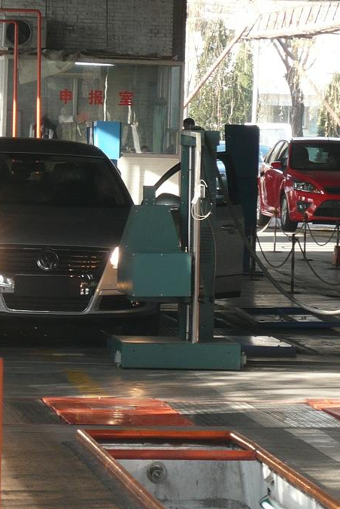
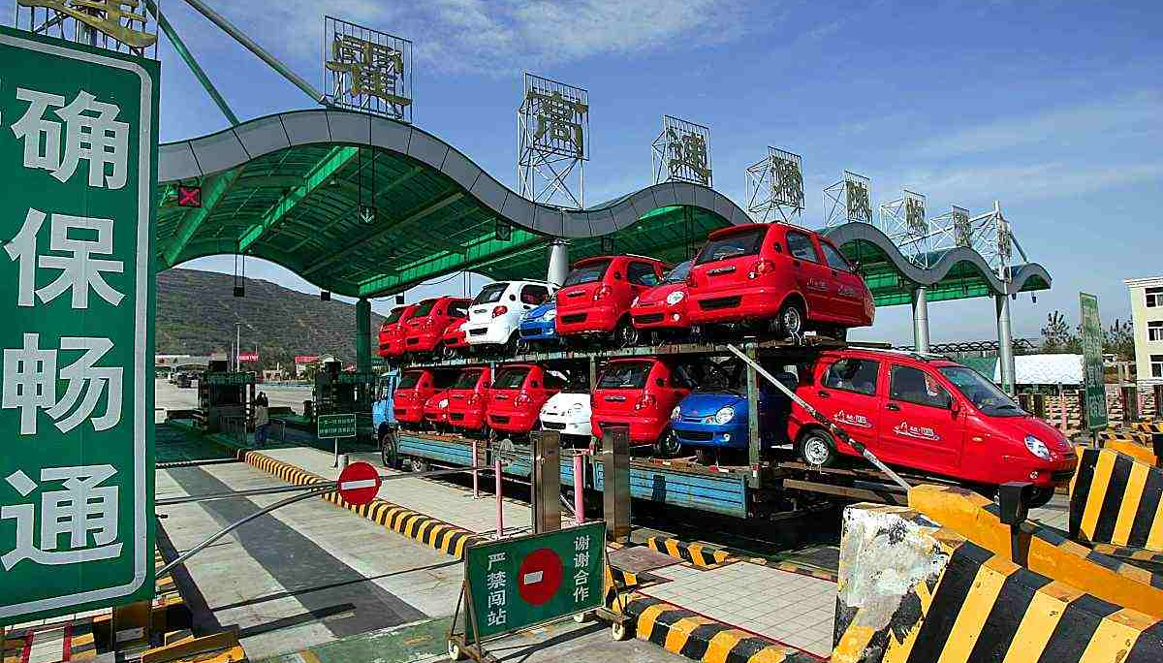
Dynamic weighing technology
Axis load analysis system
Multi-sensor fusion
The distributed pressure detection technology can isolate and calculate the load of each axle in real time, identify vehicles exceeding the limit and trigger alarm, and the minimum axle weight resolution capability is up to 50kg.
The integrated bending plate, quartz and capacitive weighing sensors are combined to process the data through Kalman filter algorithm to realize the dynamic weighing within the range of 0-120km/h, and the error rate is less than ±2.5%.
Temperature compensation mechanism
Built-in PT100 temperature sensor and compensation algorithm eliminate the effect of-30℃ to 70℃ ambient temperature difference on piezoelectric materials, ensuring annual weighing stability.

Slide 9
Vehicle automatic identification technology
Multimodal recognition fusion
Deep learning categories
Combined with RFID(5.8GHz DSRC), video recognition (2 megapixel high-speed camera) and laser contour scanning (905nm wavelength), the license plate, vehicle type and vehicle logo are verified for three times, and the recognition accuracy is more than 99.9%.
The YOLOv5 algorithm is used to train the vehicle model database (covering more than 3000 models), which supports millisecond classification of trucks, buses and special vehicles with an accuracy rate of 98.7%.
01
02
Anti-obstruction recognition
Data encryption transmission
Based on the penetration detection capability of millimeter-wave radar (77GHz), the metal reflection characteristics of vehicles can be used to assist identification even in rain or snow or when license plates are damaged.
The vehicle electronic tag (OBU) information is encrypted with the national secret SM4 algorithm, and the two-way authentication mechanism is used to prevent cloning cards and man-in-the-middle attacks. The key update cycle is less than 24 hours.
03
04

Slide 10
System workflow
03

Slide 11
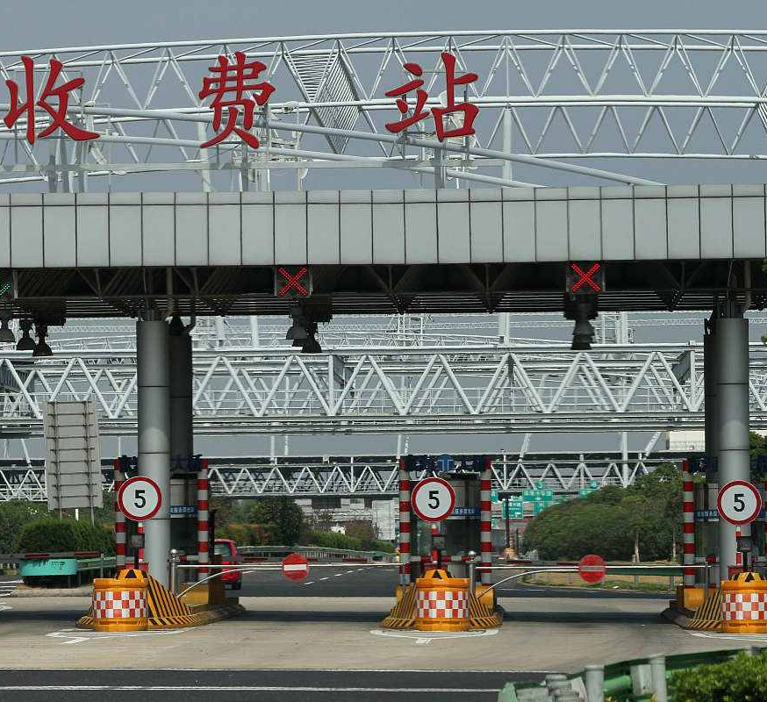
Vehicle recognition and information interaction
On-board unit (OBU) activation and authentication
When the vehicle enters the ETC lane, the roadside unit (RSU) activates the OBU through 5.8GHz microwave communication and completes two-way authentication to ensure the legitimacy of the equipment.
Real-time collection of vehicle information
Through high-definition license plate recognition camera and ground induction coil, the system synchronously obtains key information such as license plate number and vehicle type, and cross-verify with OBU data.
Secure transmission of transaction data
The transaction information is encrypted by the national secret SM4 algorithm, and the OBU and RSU are connected with each other in milliseconds through the DSRC dedicated short-range communication protocol.

Slide 12
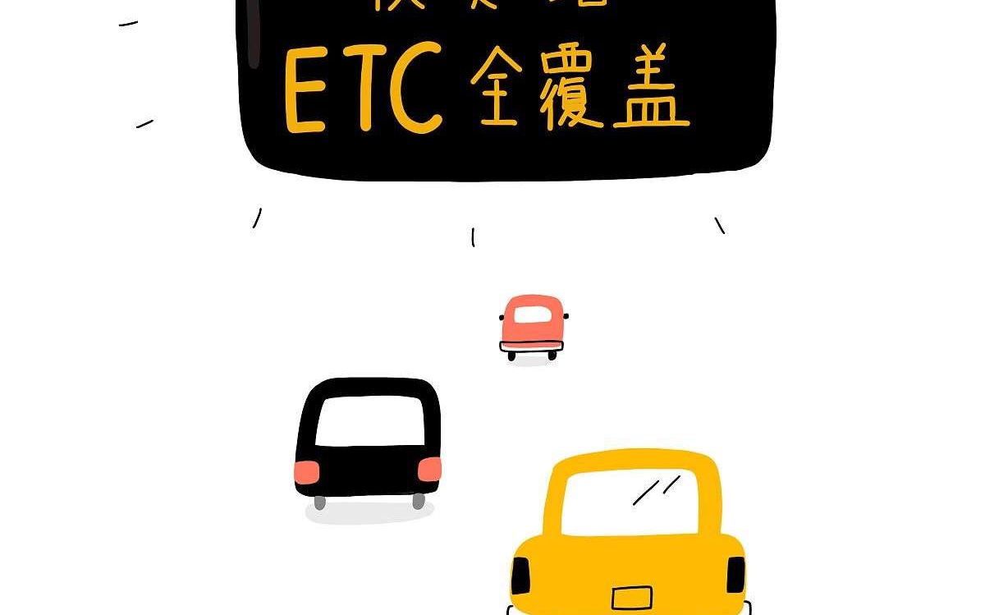
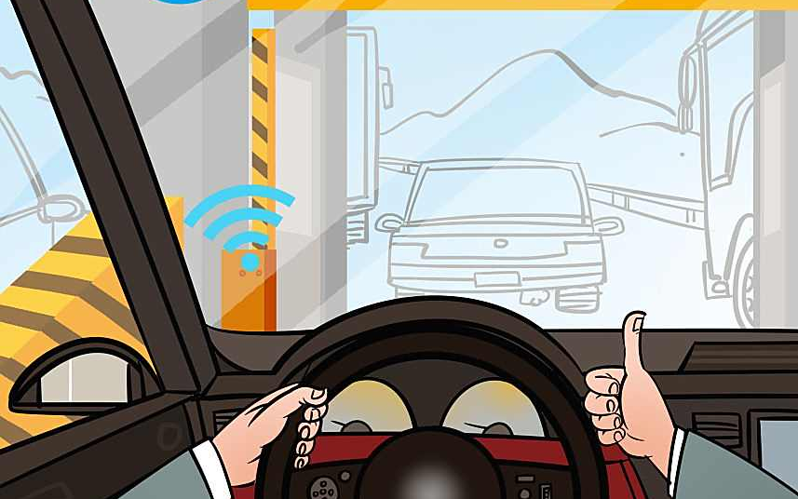
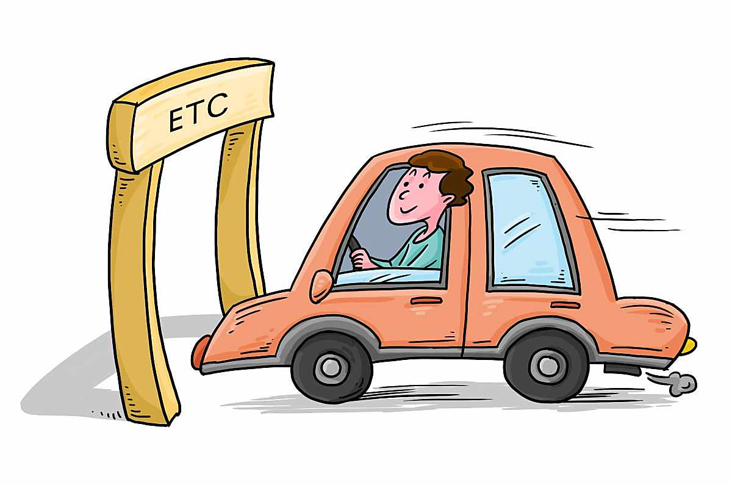
Data validation and processing
Vehicle information verification
Encryption transmission of transaction data
Abnormal data processing mechanism
The RSU (roadside unit) reads the license plate, vehicle type and other information in the OBU (vehicle-mounted unit) in real time, and compares it with the pre-stored data in the database to ensure consistency.
The asymmetric encryption algorithm (such as RSA) is used to encrypt the transaction data to prevent data tampering or theft and ensure transaction security.
In case of abnormal conditions such as signal interference and OBU failure, automatic retry or manual review process is triggered to ensure the accuracy of charging.

Slide 13
Automatic deduction and release
The vehicle information (such as license plate number and account status) of the on-board OBU (on-board unit) is read through RSU (road side unit), and verified with the background database in real time to ensure that the deduction account is valid and the balance is sufficient.
Vehicle identification and information matching
The system automatically deducts the toll from the bound payment account (bank card/third-party payment), and pushes the amount of deduction and account balance information to the owner through OBU or LED display.
Unconscious deduction fee and real-time feedback
After the fee is deducted successfully, the system sends a release instruction to the lane barrier machine to ensure that the barrier is quickly lifted when the vehicle passes at a speed below 20km/h, so as to avoid congestion and improve the passage efficiency.
Quick pole lifting and passing security

Slide 14
Key Equipments and Functions
04

Slide 15

On-board unit (OBU)
Two-way communication function
01
Supports 5.8GHz dedicated short range communication (DSRC) with roadside units (RSU) to enable vehicle identification and real-time transmission of transaction data.
Power management design
02
Built-in rechargeable lithium battery or solar power supply module to ensure low power operation, typical standby time of more than 3 years.
Anti-tampering mechanism
03
The dual protection of mechanical lock and electronic tag is adopted, which automatically fails after triggering disassembly to prevent illegal transfer of OBU.

Slide 16

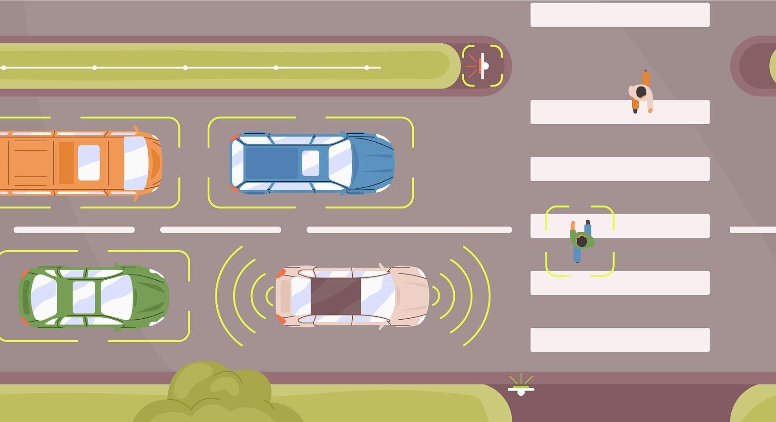
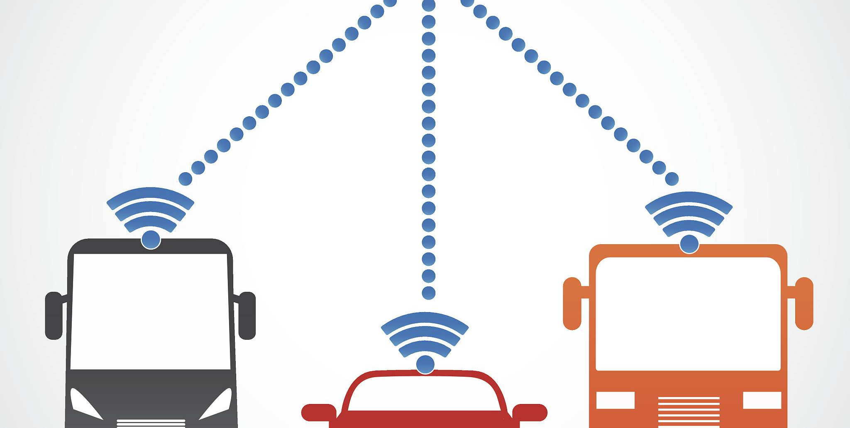
Road Side Unit (RSU)
Communication functions
Multi-lane coverage capability
Data security and encryption
Using 5.8GHz dedicated short-range communication (DSRC) technology, it exchanges vehicle information, transaction data and instructions with the on-board unit (OBU) in real time.
Through the design of high gain directional antenna, a single RSU can support the coverage of multiple lanes and reduce the cost of equipment deployment.
The SM4/SM7 national cryptography algorithm is integrated to ensure that the transaction data is tamper-proof and anti-counterfeiting, and meet the security standards of the transportation industry.

Slide 17
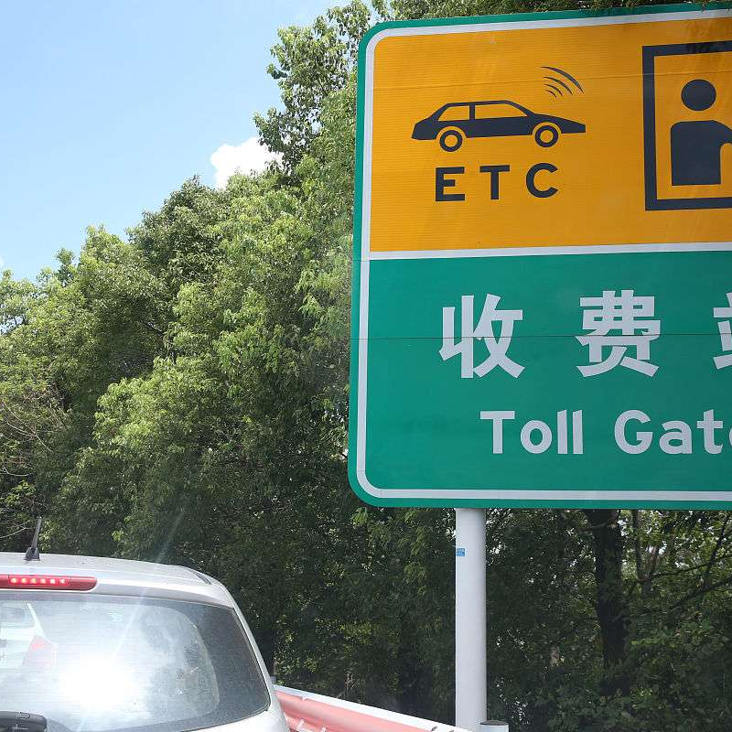
Back-end management system
User account and transaction management
Data collection and analysis
Provide user registration, account recharge, transaction record query and abnormal transaction processing functions to ensure transparent and efficient capital flow.
Real-time receipt and storage of transaction data from roadside units (RSU) to support big data analysis to optimize tolling strategies and traffic flow management.
Equipment monitoring and operation support
Monitor the operating status of remote OBU (vehicle unit) and RSU, automatically alarm faulty equipment and generate operation and maintenance work order to ensure system stability.

Slide 18
Technical Advantages and Challenges
05

Slide 19

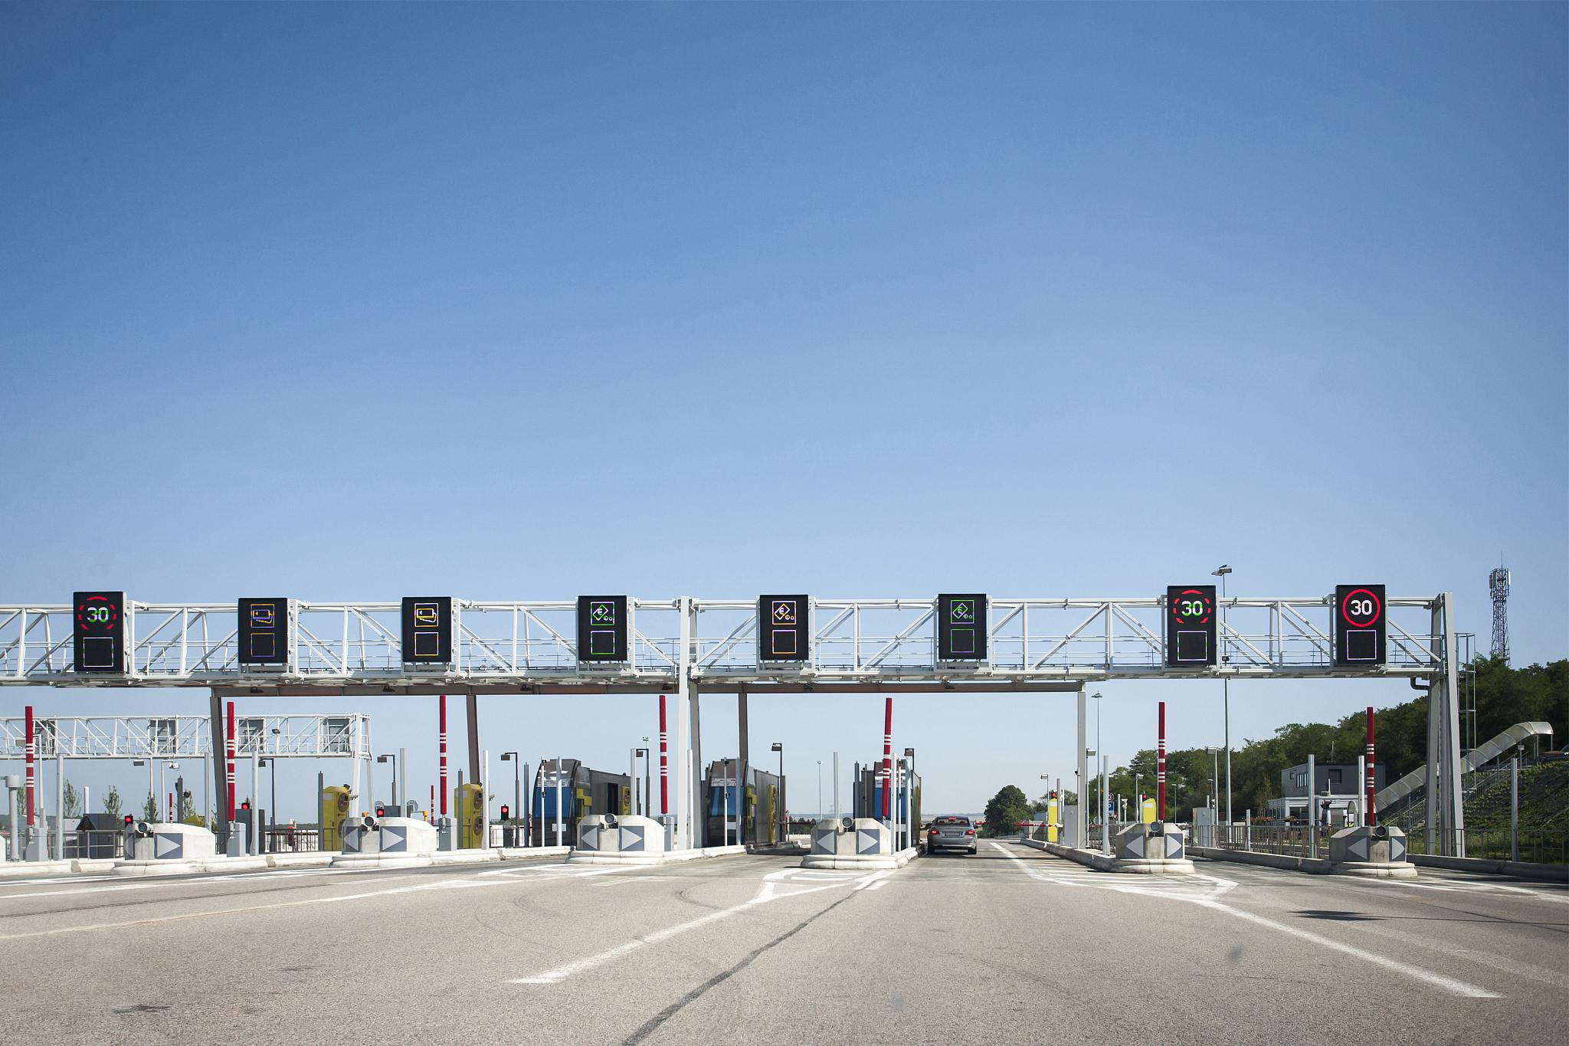
Efficiency and stability
Quick pass capacity
The ETC system uses microwave communication technology, so the vehicle does not need to stop when passing through the toll station, and the speed can reach 40-60 km/h, greatly improving traffic efficiency.
High identification accuracy
Through the accurate communication between the on-board unit (OBU) and the roadside unit (RSU), the identification accuracy is more than 99.5%, ensuring the reliability of the charging process.
System redundancy design
The system adopts the technical means of double machine hot backup and data synchronization to ensure stable operation in case of hardware failure or network abnormality and guarantee the continuity of charging service.

Slide 20


Safety and reliability
Data encryption and tamper-resisitant
Advanced encryption standard (AES) and digital signature technology are adopted to ensure that transaction data is not stolen or tampered with during transmission and storage.
Redundant backup and fault tolerance mechanisms
Through the distributed server architecture and real-time data synchronization, single point failure is avoided and the system continues to operate under extreme conditions.
Identity authentication and anti-counterfeiting technology
The bidirectional authentication of the OBU (vehicle unit) and RSU (road side unit) is combined to prevent the use of forged equipment or illegal vehicles to take advantage of ETC channels.

Slide 21
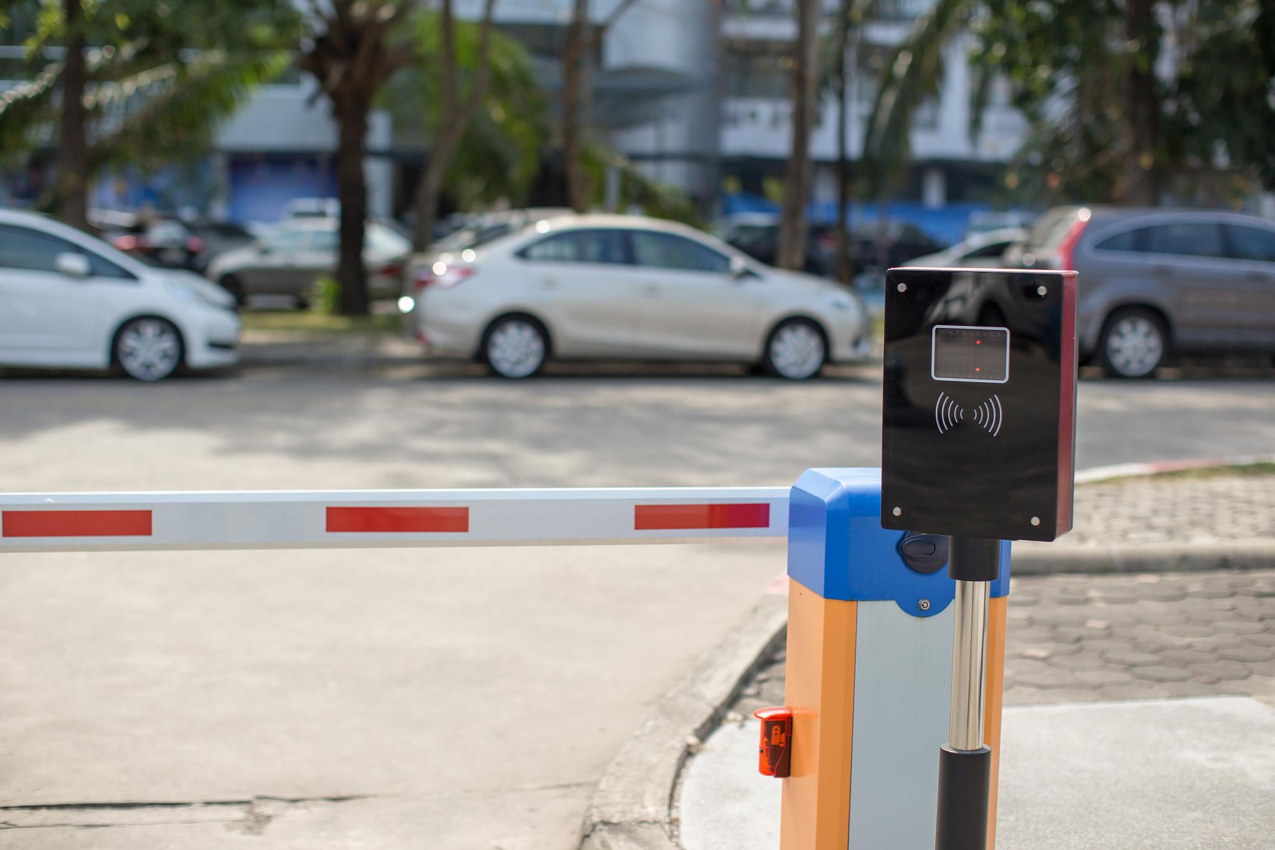
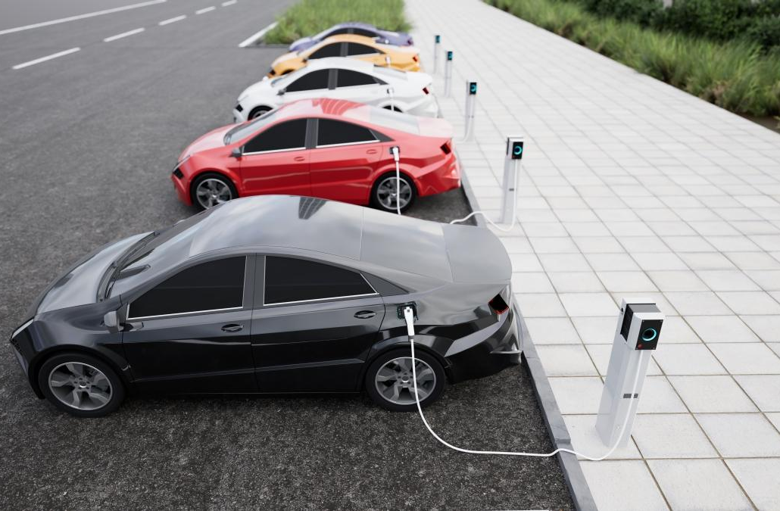
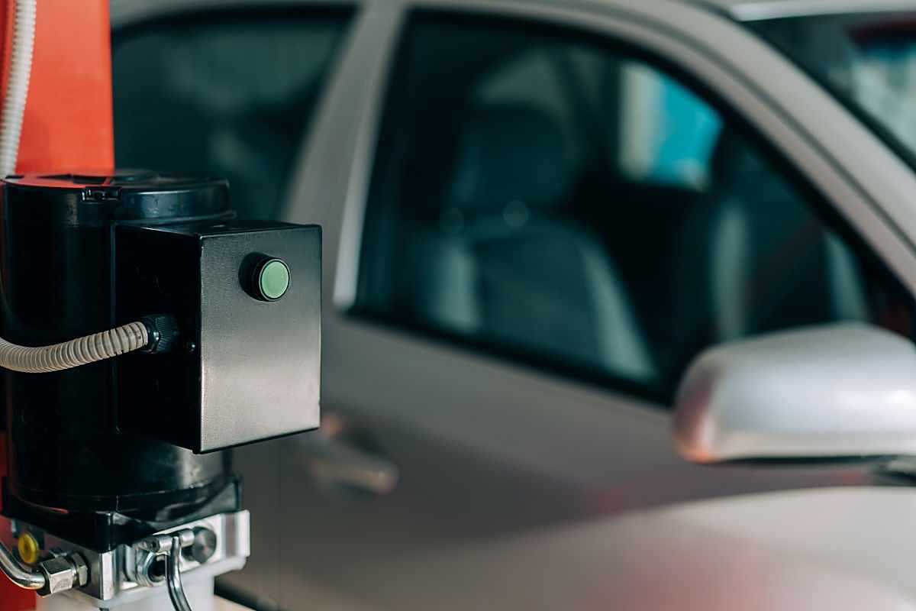
Environmental adaptability issues
Impact of extreme weather
Multi-vehicle mixed scenarios
The system needs to maintain stable recognition rate in bad weather such as rain, snow and haze, and anti-interference algorithm and high sensitivity sensor should be used.
For different lanes (such as ETC dedicated lane and mixed lane), the communication protocol should be dynamically adjusted to avoid signal conflict or missed reading.
Electromagnetic interference protection
The high-voltage equipment or wireless equipment around the toll station may interfere with signal transmission, so the shielding design and frequency band selection of the RF module should be optimized.

Slide 22
Application Cases and Development Trends
06

Slide 23
Implementation case of typical section
Main toll station of expressway
Through the design of full coverage of ETC lanes, vehicles can pass without feeling at a speed of 20-30km/h, improving the traffic efficiency by 300% and the rate of manual intervention less than 5%.
Urban congestion charging zone
Trans-provincial network charging system
Cities such as London and Singapore have adopted ETC technology to realize dynamic congestion charging, combined with license plate recognition and RFID technology, the toll accuracy rate in peak hours reaches 99.8%.
Chinas "One National Network" project integrates ETC systems in 29 provinces, supports cross-provincial non-stop settlement, with an average daily transaction volume exceeding 30 million and an error rate of less than 0.01%.

Slide 24

Integrated and innovative applications of rectify overloading
Dynamic weighing and ETC linkage
By integrating dynamic weighing equipment into ETC gantry, truck overload behavior can be detected in real time, and data can be automatically intercepted and pushed to the law enforcement platform.
Credit punishment mechanism
The overload violation records will be included in the ETC credit system, and the access rights or rates of high-frequency overloaded vehicles will be restricted to form a long-term governance constraint.
Multi-source data collaborative analysis
Based on ETC traffic data, GPS trajectory and load information, the overload risk prediction model is constructed to realize accurate control and source management.

Slide 25
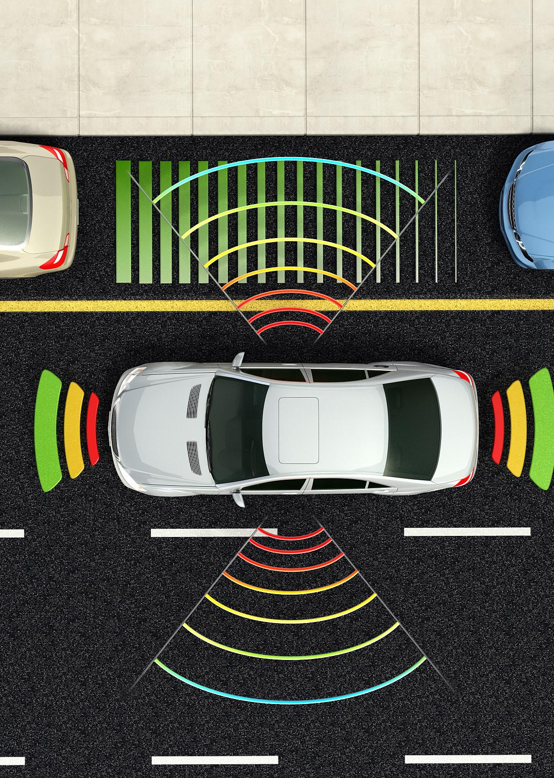

Future technology upgrade direction
Multimodal fusion recognition technology
By combining license plate recognition, RFID and AI vision technology, the vehicle recognition accuracy can be improved in complex scenarios and the misjudgment rate can be reduced.
5G-V2X collaborative communication
Real-time data interaction is realized through 5G network and vehicle-to-everything (V2X) technology, which supports dynamic rate adjustment and path optimization.
Indifferent payment extensions
Integrate ETC and mobile payment platform, expand the seamless payment ecology in parking lots, gas stations and other scenarios, and improve user convenience.

Slide 26
THANKS

