Slide 1

Smart Classroom Scenario Solutions for Higher Education
Technology Forges the Future, Strength Builds the Brand
Notes:
Welcome to our presentation on Smart Classroom Scenario Solutions for Higher Education. Today, we will explore how cutting-edge technology is reshaping the future of teaching and learning, and how our solutions empower institutions to build a strong, forward-thinking brand in the digital age.

Slide 2

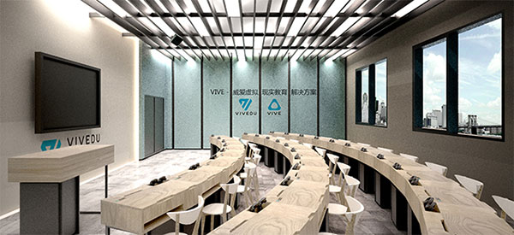
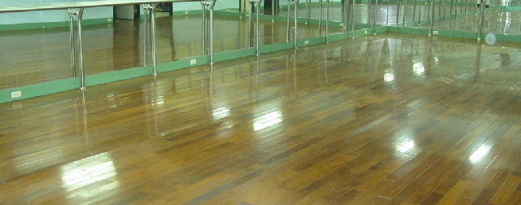
Classification of Classroom Types
01. Immersive & Connected Spaces
Interactive Live Classrooms bridge distances for real-time collaboration, while Virtual Training Rooms leverage VR/AR to create engaging, simulated learning environments.
02. Technical & Performing Arts Labs
Computer Classrooms equip students with high-performance tech for digital skills, and Dance Studios provide professional-grade spaces for physical expression and artistry.
Core Value:These specialized environments transcend traditional teaching models, integrating technology, creativity, and hands-on practice to foster deeper engagement and skill mastery across disciplines.
Notes:
First, let's look at the classification of classroom types. Category one includes highly specialized and interactive environments. This ranges from interactive live classrooms that bridge distances, to computer labs, virtual training rooms using VR technology, and dedicated dance studios.

Slide 3
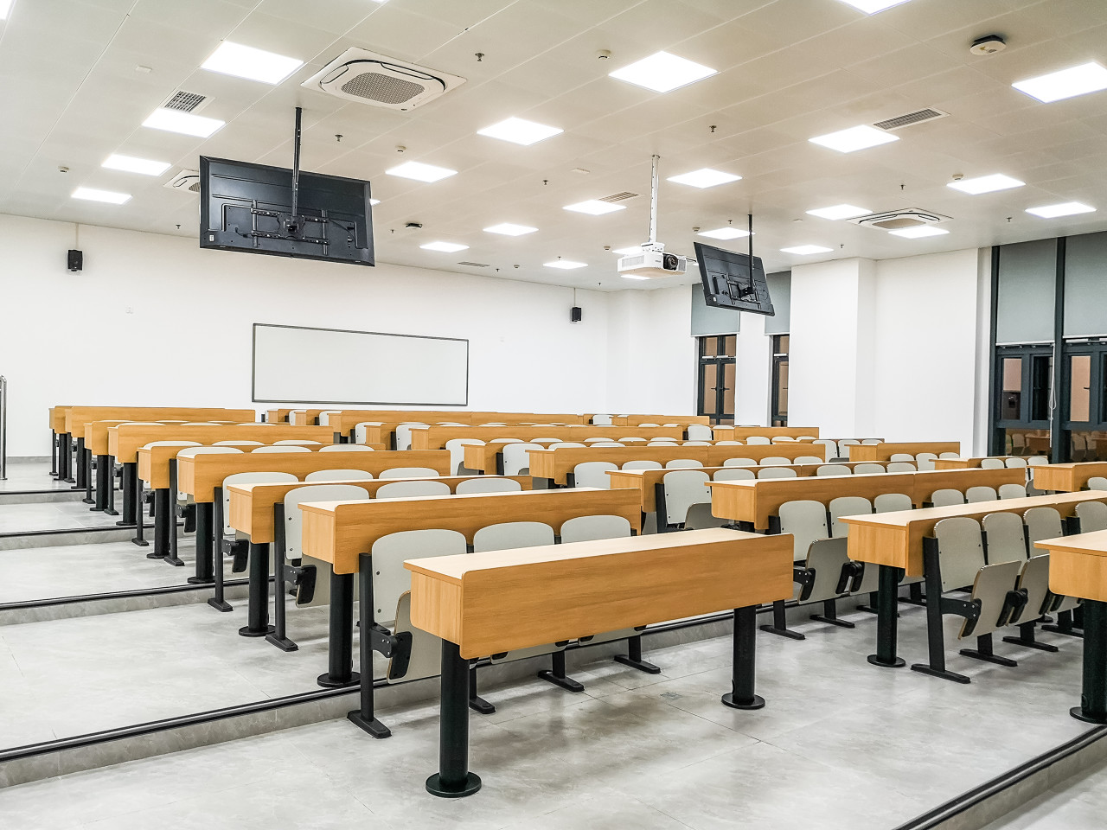
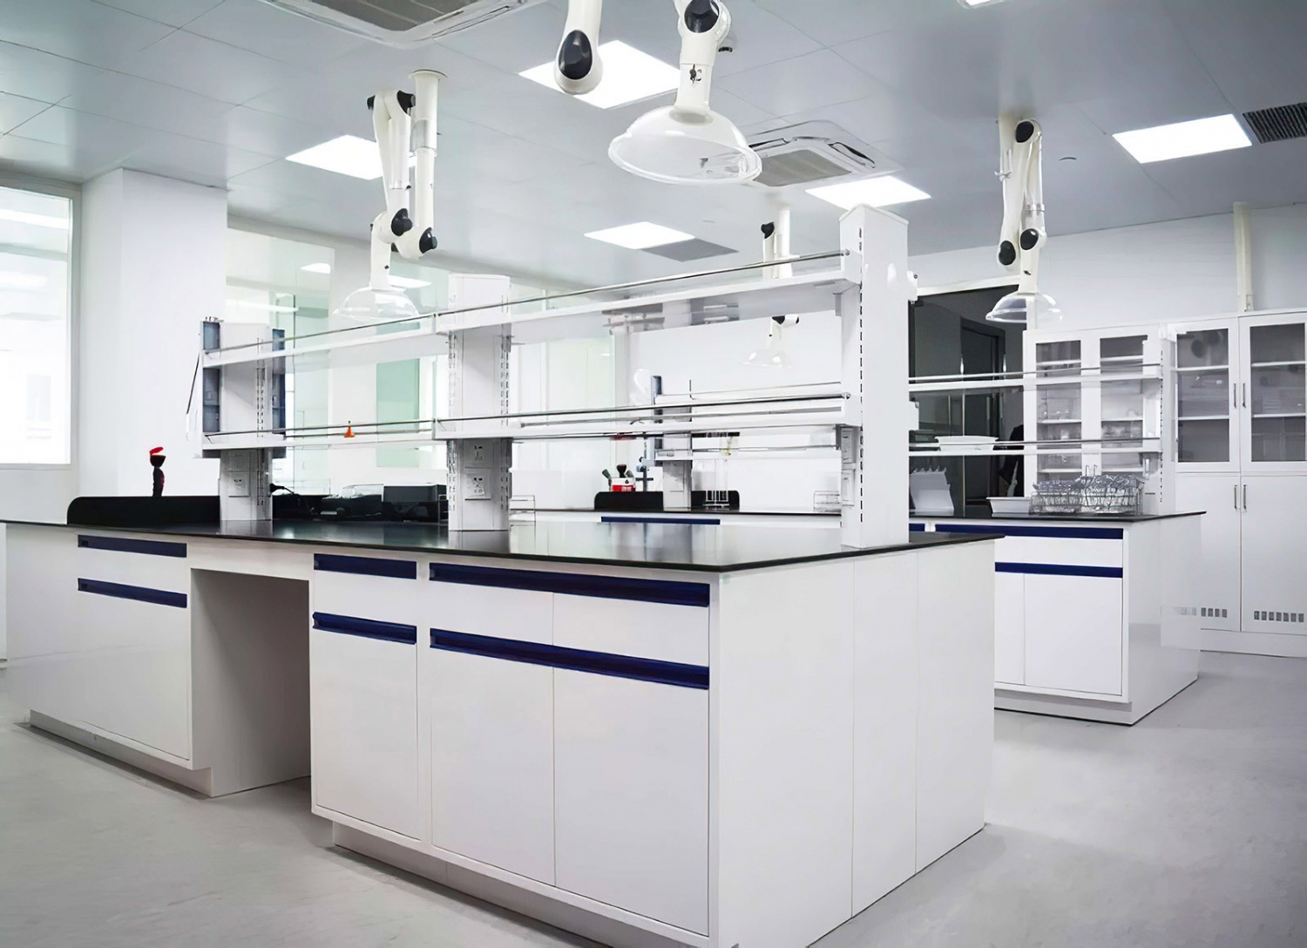
Classification of Classroom Types
03. Lecture Hall
05. Lab Classroom
Engineered for large audiences, featuring advanced audio-visual setups to maintain clear communication and visibility for every attendee.
A dedicated environment for hands-on scientific inquiry and experimentation, equipped with specialized tools for STEM disciplines.
04. Standard Classroom
06. Seminar Classroom
The cornerstone of academic delivery, optimized for lectures and tutorials. Designed with ergonomic seating and acoustics to prioritize focus and direct engagement between educators and learners.
An intimate space fostering small-group interaction and dynamic discussion. Encourages peer-to-peer learning and deep, critical analysis of subject matter.
Notes:
Category two encompasses the standard and academic core of any university. This includes the standard classrooms, large lecture halls for major presentations, intimate seminar rooms for in-depth discussions, and well-equipped lab classrooms for scientific research and experimentation.

Slide 4
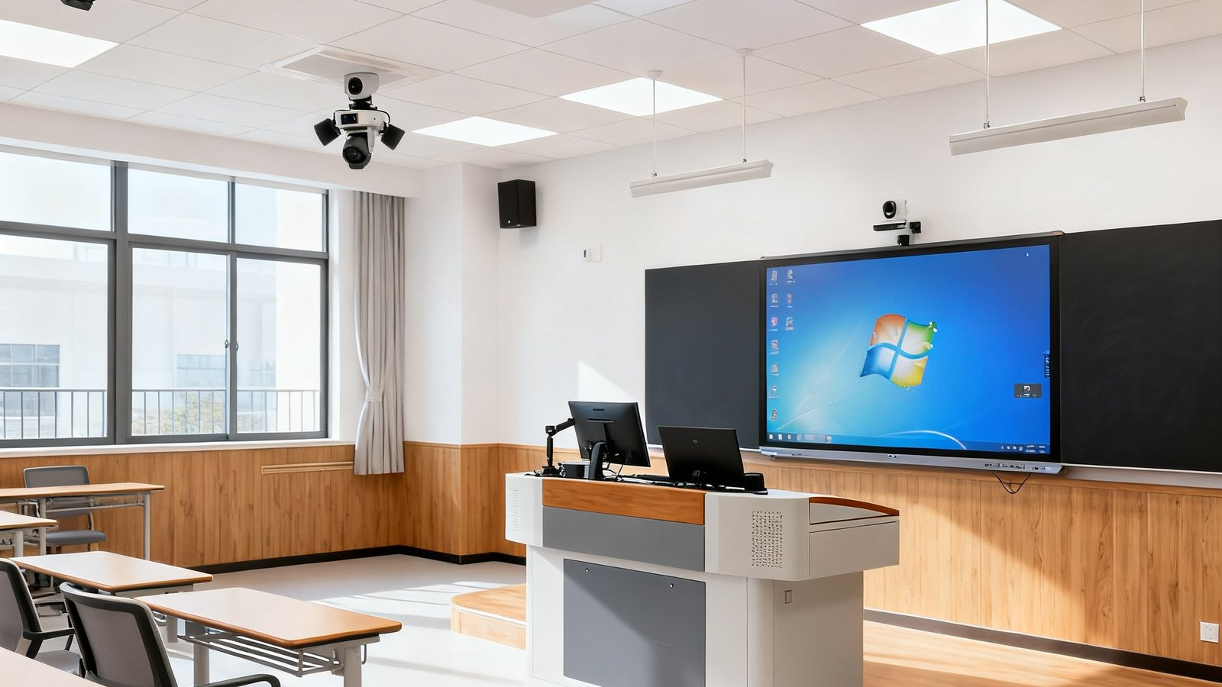
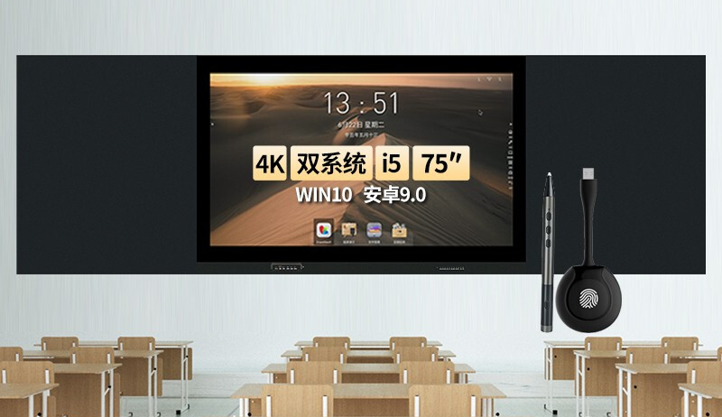




Classification of Classroom Types
Digital & Hybrid
Learning Ecosystem
A cutting-edge infrastructure that merges physical and virtual learning environments, empowering flexible, interactive, and personalized teaching experiences for modern education.
Recording & Broadcasting Classroom
Captures high-quality lectures for live streaming and on-demand review, breaking geographical barriers for remote and hybrid learning.
Psychological Assessment & Training
A private, secure space equipped with professional tools for mental health counseling, personality assessments, and emotional skill-building.
Multimedia Interactive Classroom
Blends smart whiteboards, IoT devices, and audio-visual tech to create an immersive, collaborative, and engaging teaching atmosphere.
Micro-lesson Production Studio
A compact studio for creating short, focused video lessons (micro-lectures) to support flipped classrooms and personalized learning paths.
Notes:
Category three focuses on digital and hybrid learning environments. This includes recording and broadcasting classrooms for content creation, specialized rooms for psychological assessment, multimedia classrooms that blend various technologies, and micro-lesson studios for producing concise educational videos.

Slide 5
Classroom Scene Solution
Technology Forges the Future, Strength Builds the Brand
Smart Education Ecosystem · Immersive Interaction · Data-Driven Teaching
Notes:
Now, let's move on to the core of our discussion: the classroom scene solution. We believe that technology is the key to forging the future of education, and our robust solutions are designed to build a strong and innovative brand for your institution.

Slide 6
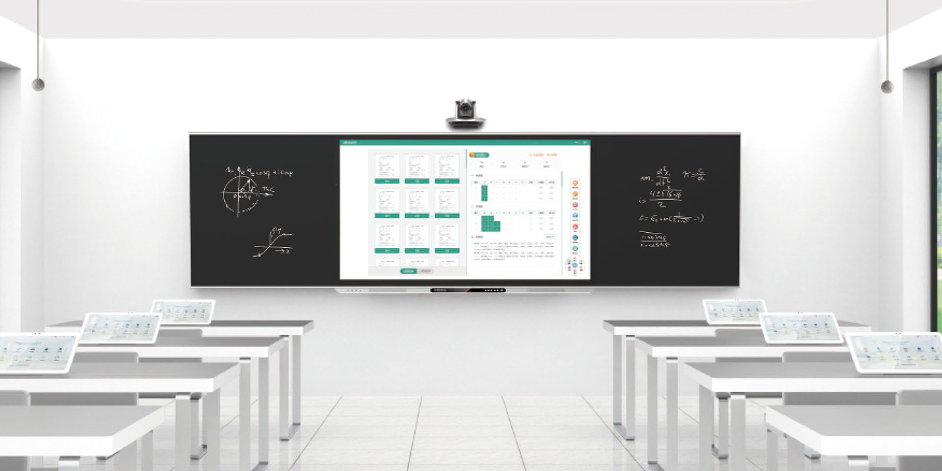

Core Advantages & Construction Outcomes
4K Ultra HD Visual Experience
Delivers razor-sharp details and vibrant, lifelike images to boost student focus and engagement. The dual-screen mutual control function allows teachers to annotate content conveniently while seated, streamlining lesson preparation and ensuring seamless, barrier-free large-screen teaching.
All-Scenario Audio Reinforcement
Our smart classroom solutions seamlessly integrate cutting-edge display and audio technologies to create an immersive, interactive, and efficient teaching environment that empowers both educators and learners.
The integrated sound system frees teachers from handheld microphones, supporting seated instruction, standing annotations, and dynamic student interactions. It delivers crystal-clear, high-fidelity audio to ensure every instruction and discussion is heard with perfect clarity across the classroom.
Notes:
Our solutions offer several core advantages. Firstly, our 4K Ultra HD displays provide stunning visual clarity, enhancing student engagement and simplifying teaching workflows. Secondly, our high-fidelity audio systems ensure every word is heard clearly, whether the teacher is sitting, standing, or interacting with students, freeing them from the constraints of a handheld microphone.

Slide 7



Core Advantages & Construction Outcomes
One-Click Scene Scheduling
Standardized Interfaces
Enterprise-Grade Data Security
Seamlessly activates multi-device linkages—including displays, lighting, and audio—with a single command. Smart sensors automate environmental adjustments, fostering an immersive and distraction-free educational atmosphere for optimized teaching.
Unified protocols maximize cross-device compatibility, significantly reducing deployment costs and complexity. Enables intuitive multi-terminal management of campus IoT ecosystems from anywhere, streamlining operational oversight.
Protects critical data with robust disaster recovery backups and military-grade encryption. Redundant systems ensure data integrity and continuity against cyber threats, system failures, or unexpected disruptions.
“Empowering smart campuses with seamless control, universal connectivity, and uncompromising security.”
Notes:
Further advantages include one-click scene scheduling, which allows teachers to instantly activate the perfect environment for their lesson with a single touch. Our standardized interfaces ensure seamless integration and cost-effectiveness. Most importantly, we prioritize data security with robust backup and encryption strategies to protect your valuable information.

Slide 8
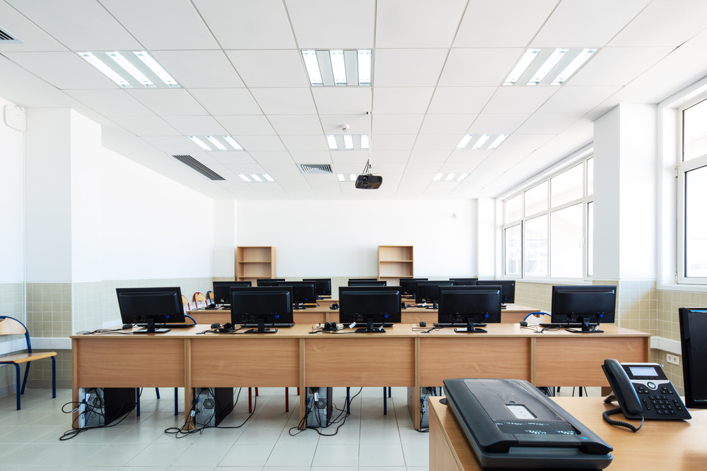
Renderings of Typical Classroom Scenarios
Large Lecture Hall
Optimized for large-scale presentations with superior visibility and acoustics for all attendees.
Virtual VR Classroom
Immersive 3D environments enable experiential, hands-on learning across diverse subjects.
Laboratory Classroom
Smart, safe labs with integrated IoT monitoring, automated control and real-time data capture.
Recording & Broadcast
Professional studios for high-quality lecture capture, live streaming and educational content production.
Computer Classroom
High-tech hubs with powerful workstations for coding, AI design, programming and digital education.
Notes:
Let's visualize these solutions in action. From a grand lecture hall to an immersive VR classroom, a state-of-the-art lab, a professional recording studio, and a modern computer lab, our technology seamlessly integrates into any educational setting to create an enhanced learning experience.

Slide 9
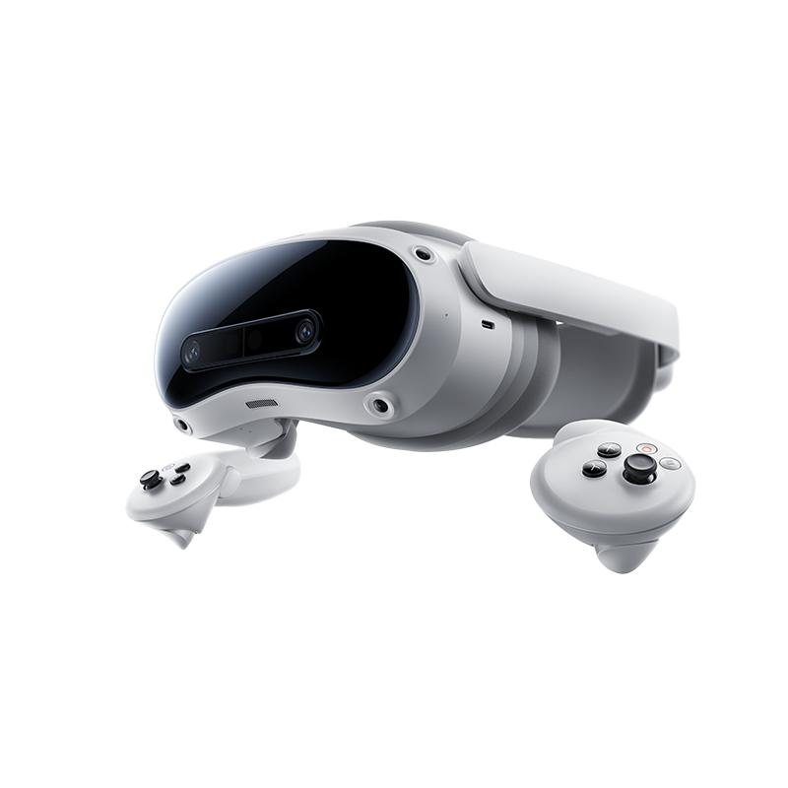

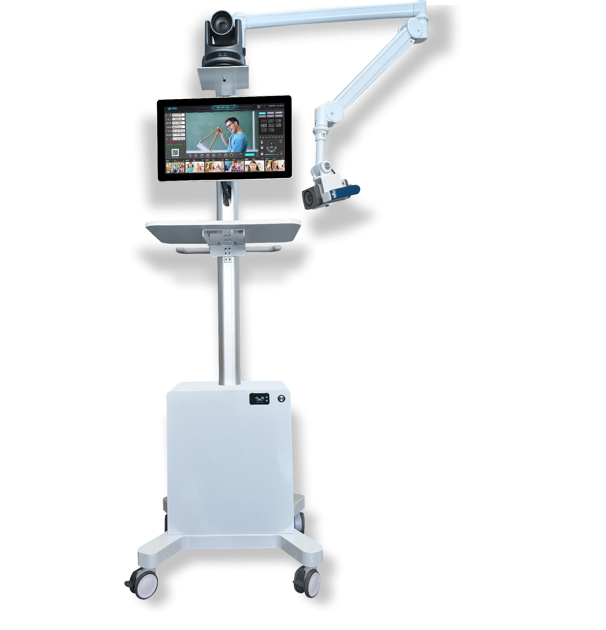



System Design Modules
Classroom Management
Central hub for controlling and monitoring all smart devices, ensuring seamless operation.
All-Scenario Audio
360° coverage with noise reduction, ensuring clear audio for lectures and group discussions.
Interactive Smart Display
4K LED panel for vivid content, annotations, and real-time teacher-student interaction.
Collaborative Seminar
Tablet-integrated workstations enabling interactive group work and instant feedback sharing.
IoT Device Terminal
Unified gateway connecting sensors, cameras, and appliances for smart environment control.
VR Immersive Learning
High-end VR headsets for virtual labs, 3D modeling, and immersive educational scenarios.
Edu Recording System
AI auto-tracking for high-quality lecture capture, live streaming, and on-demand playback.
Mobile Recording Unit
Portable cart with professional cameras and mics for flexible recording in any setting.
Notes:
The technical foundation of our solution lies in its modular design. This includes a central classroom management system, interactive displays like smart blackboards, multimedia IoT terminals, professional recording systems, comprehensive sound solutions, group collaboration tools, VR equipment, and flexible mobile recording systems.

Slide 10
Audio & Video Solution for Smart Classrooms
The construction of university smart classrooms takes the cloud-based classroom data center as the foundation. Combined with intelligent information equipment, it transforms classrooms into multi-functional, versatile and intelligent comprehensive teaching spaces, realizing interconnection, interaction and mutual control among various types of university classrooms to meet diverse teaching demands.
Cloud Classroom Control System
Classroom Intelligent Management System
Intelligent Interactive Podium System
All-Scenario Sound Reinforcement System
Regular Recording & Broadcasting System
High-Quality HD Recording System
Virtual Simulation VR All-in-One Device
Group Collaborative Seminar System
Mobile Training & Lecture Recording
Smart Blackboard & Whiteboard
4K Educational All-in-One Display
Ultra-Narrow LED All-in-One Display
Notes:
Our audio and video solution is built around a cloud-based data center. This core, combined with smart devices, turns traditional classrooms into highly versatile, interconnected spaces. The system portfolio is extensive, covering everything from cloud control and sound systems to VR devices, smart displays, and various recording solutions, all designed to meet diverse teaching needs.

Slide 11
PART 03
Overall Construction Plan
A comprehensive roadmap addressing industry challenges through strategic design, phased execution, and dynamic resource optimization to ensure seamless project delivery.
Notes:
Now, let's discuss the overall construction plan. This section will address the key challenges in the industry and how our comprehensive approach provides a strategic solution.

Slide 12




Industry Pain Points
Inconsistent Equipment
Redundant Equipment
Lack of Unified Standards
Disparate operation modes increase complexity, raising teachers’ usage barriers and maintenance workload, which directly impacts the efficiency of daily teaching activities.
A large number of independent multimedia devices cause redundant stacking, occupying excessive physical space and increasing energy consumption and daily management costs.
Proprietary manufacturer specifications without top-level planning lead to repeated investment, resource waste, and make unified campus-wide management extremely difficult.
Multimedia IoT Classroom System Overview
Built on IoT, cloud computing, big data, and AI, our system seamlessly integrates with existing digital campus platforms. It provides intelligent services like on-demand resource allocation, automatic classroom recording, real-time environmental monitoring, and smart device scheduling. This creates a highly efficient, eco-friendly, and secure next-generation smart classroom ecosystem that eliminates equipment silos, reduces waste, and optimizes resource utilization for a truly connected teaching environment.
Notes:
The industry currently faces significant pain points: inconsistent equipment creates usability issues, redundant hardware wastes space and resources, and a lack of unified standards leads to inefficiencies. Our Multimedia IoT Classroom System addresses these issues by leveraging cutting-edge technologies to create a unified, efficient, and secure ecosystem that integrates seamlessly with your existing digital infrastructure.

Slide 13






Core System Capabilities
01 Big Data Analysis
04 Remote Management
Statistically analyzes campus data to inform teaching strategies and optimize administrative decisions with data-driven insights.
Real-time remote monitoring and diagnostics of equipment status and environmental parameters from a central hub.
02 Integrated Hardware
05 Smart Scene Switching
Consolidates matrix, central controller, amplifier, and computer into a single, compact unit for space-saving efficiency.
One-touch recall of pre-configured lighting, audio, and display settings for lectures, discussions, or exams.
Empowering smart teaching with a holistic ecosystem that blends cutting-edge hardware and intuitive software. Designed to simplify management, enhance interactivity, and create seamless, future-ready learning environments for educators and students alike.
03 Multi-Terminal Control
06 All-Scenario Audio
Accessible anytime via mini-programs, mobile apps, wall panels, or web portals for flexible, on-the-go management.
Adaptive sound reinforcement modes ensure clear audio coverage, supporting diverse teaching styles and activities.
Notes:
The core capabilities of our system are powerful and diverse. We offer big data analysis for informed decision-making, highly integrated hardware to save space and simplify operation, and flexible control from any device. Our system also enables remote management, quick scene switching, and an all-scenario sound reinforcement solution that adapts to any teaching style.

Slide 14


Centralized Classroom Equipment Management
Diversified Control Modes
All-Scenario Sound Reinforcement
Seamlessly manage devices through mobile apps, web dashboards, or wall-mounted touch panels, adapting to different user habits and teaching scenarios.
Crystal-clear audio coverage optimized for lectures, group discussions, or multimedia playback, ensuring every student captures the lesson content without distraction.
Proactive Equipment Maintenance
One-Tap Scene Switching
Real-time remote diagnostics and health monitoring identify potential issues early, enabling predictive maintenance to minimize downtime and extend device life.
Instantly adapt the classroom environment—adjusting lighting, audio, and display settings—between lecture, seminar, or video modes with a single command.
Notes:
Centralized management is a key feature. Our platform brings all classroom equipment under one umbrella, offering diverse control modes, a comprehensive sound solution, simplified operation and maintenance, and the ability to switch between multiple pre-configured scenes instantly. This streamlines administration and enhances the teaching experience.

Slide 15
PART 04
Group Seminar System
Collaborative Learning & Interactive Discussion Platform
A dedicated digital ecosystem crafted to elevate small-group pedagogy, fostering dynamic peer-to-peer engagement, real-time knowledge exchange, and efficient academic collaboration within educational institutions.
Notes:
Next, we focus on a specialized solution for collaborative learning: the Group Seminar System. This system is designed to transform small-class teaching and discussion-based courses.

Slide 16



Application Scenarios & Core Value
Interactive Learning Scenarios
Perfect for seminar-based courses, small-class teaching, and open-reservation sessions. It enables seamless multi-group interaction, collaborative note-taking, and live topic-based presentations, turning passive listening into active participation.
Core Value Proposition
Empower Students:Provide a platform for confident sharing of work and ideas, building communication and presentation skills.
Teacher Control:Assign tasks, moderate discussions, and leverage tools like screen casting, real-time annotation, mind mapping, and screen recording to guide effective learning.
“A dynamic environment where ideas flow freely and collaboration thrives, redefining the small-class learning experience.”
Notes:
The Group Seminar System is perfect for interactive, small-group settings. It supports multi-screen interaction, group note-taking, and presentations, significantly boosting learning efficiency. The core value lies in empowering student presentations and enabling teachers to guide and manage group discussions with powerful tools like screen sharing and mind mapping.

Slide 17

Current Teaching Challenges
01. One-way Delivery
02. Low Participation
03. Integration Gaps
Insufficient teacher-student interaction creates a passive learning environment, making it hard to track individual progress and adapt teaching strategies.
Lack of convenient channels for sharing and discussion stifles student engagement, leading to limited peer-to-peer learning and feedback.
Technology fails to embed deeply into core teaching workflows, resulting in disjointed tools and low adoption rates among educators.
04. Isolated Data Silos
05. Dispersed Management
Valuable teaching and learning data remains unstructured and unshared across departments, preventing data-driven insights and improvements.
Lack of a visualized centralized hub leads to heavy administrative burdens, inefficient resource allocation, and poor oversight of classroom activities.
The Integrated Group Seminar System:A holistic solution combining dual-screen teaching, multi-device interaction, real-time in-class assessments, and comprehensive evaluations to foster dynamic, collaborative learning and efficient knowledge sharing.
Notes:
This system directly addresses several current teaching challenges, such as passive learning, low participation, and fragmented data. Our Group Seminar System is a holistic solution that combines interactive teaching, quizzes, and evaluation into one seamless platform, specifically designed to foster active, collaborative learning.

Slide 18



Rich Teaching Tools
In-Class Quizzes
Cloud Lesson Prep
Mobile Classroom Control
Syncs with lesson plans for real-time interactive quizzes and instant result analysis. Supports PPT synchronization, dynamic annotations, and live scoreboards to boost student engagement.
Build courses, upload resources to secure cloud storage, and share materials directly with students—no USBs required. Access and update lesson plans anytime, anywhere for seamless preparation.
Use your phone as a smart remote to control the screen, draw annotations, capture and push snapshots, stream live videos, or activate a visual magnifier for flexible, untethered teaching.
Empowering educators with intelligent tools to create interactive, efficient, and dynamic learning environments.
Notes:
The system is equipped with a suite of rich teaching tools. Teachers can conduct in-class quizzes for instant feedback, prepare lessons efficiently with cloud-based materials, and control the classroom environment remotely using a mobile app. These tools save time and enhance the interactivity of every lesson.

Slide 19


Thank You
Smart Classroom Scenario Solutions for Higher Education
Together, we transform traditional learning spaces into dynamic, interactive hubs for innovation and growth.
Notes:
Thank you for your time. We believe that our smart classroom solutions are the key to unlocking the full potential of modern higher education. We look forward to partnering with you to build the classrooms of tomorrow, today.

